Slide 1
CRIME DATA ANALYSIS

Slide 2
Introduction
Crime Visualizations:
“Theft from Vehicle” Crimes: Displayed on the Vancouver map in red, highlighting locations of these incidents.
“Mischief” Crimes: Displayed on the Vancouver map in blue, indicating locations of these incidents.
Neighborhood Analysis:
Identified the neighborhood with the highest number of total crimes.
Monthly Trend Analysis:
Visualized the trend of total number of crimes by month across different years.

Slide 3
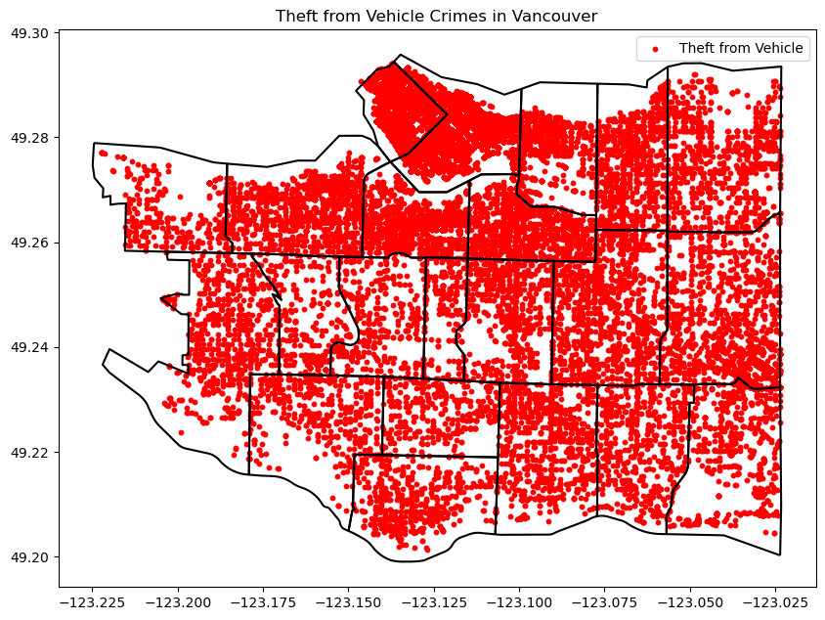
Visualizing the “Theft from Vehicle” crimes over Vancouver

Slide 4
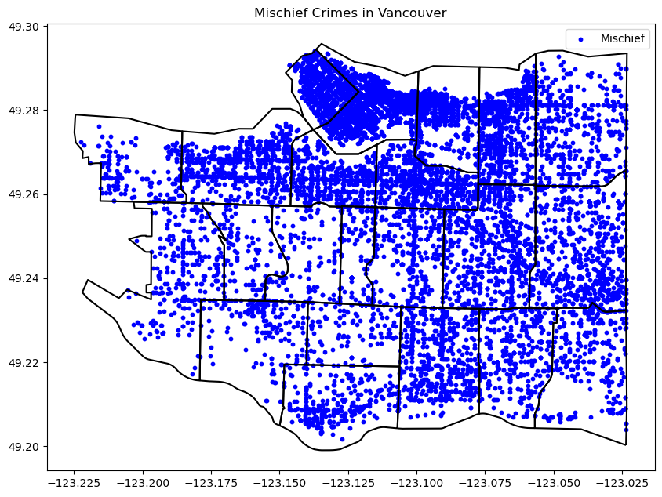
Visualizing the “Mischief” crimes over Vancouver

Slide 5
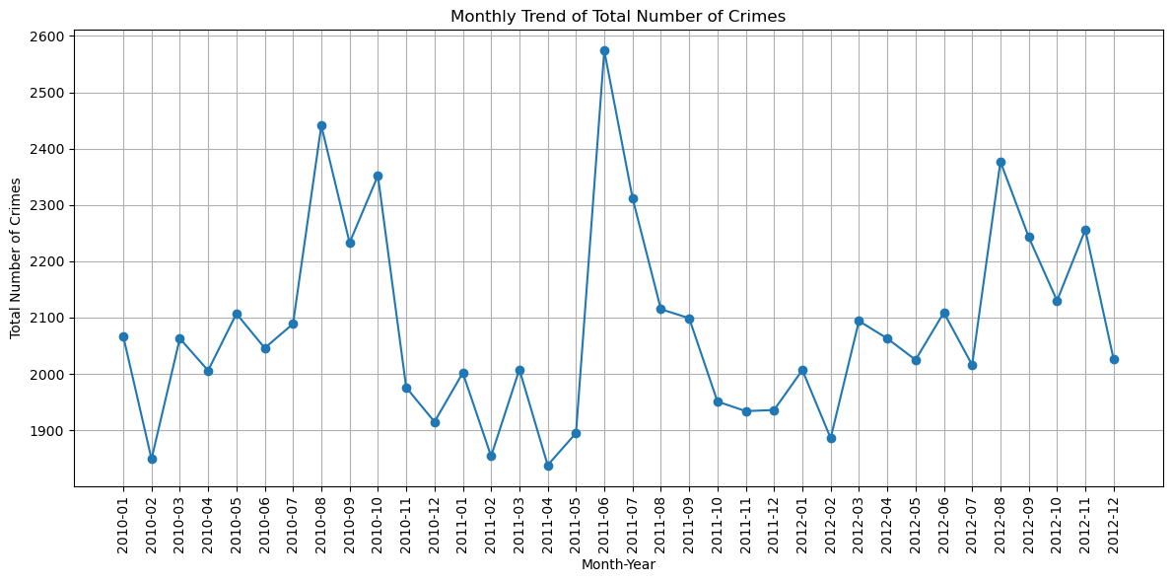
Monthly trend of total number of crimes

Slide 6
Findings
When the monthly crime rates are analyzed, it is found that the highest crime rate is recorded on June 2011
The lowest crime rate is recorded in two different months of different years which is February 2010 and April 2011
The trend shows equal spikes and downfall in crime rates
The highest crime rate recorded was above 2500 in 2011

Slide 7
Findings cont..
Downtown is recorded to have the highest number of crimes
Around 16884 crimes is recorded in this region
Over the years 2010, 2011 and 2012 the crime rates has reduced.
The highest crime rate was recorded in 2010
The difference
2010- 12777 total
2011- 12129 total
2012- 12183 total

Slide 8
Conclusion
After analysis it is found that the crime rate in Vancouver is pretty high when compared in years 2010, 2011 and 2012.
After the highest recording in 2010, the crime rate has changed and improved
But there has not been any significant improvement and the main analysis has been made for theft in vehicles and mischief
Steps has to be taken to reduce the crime rate

